Slide 1
STUDENT MANAGEMENT SYSTEM
BY
Chetana Patil
Axis-B1014

Slide 2
Introduction
Student management system deals with efficient and user friendly maintenance of student details.
Student Management System is a web-based application that handles basic functions of students.
Student management system is managed by an administrator. It provides personal details of students.
User-Friendly as the system is very interactive and can be easily operated.

Slide 3
Objective
Student management system deals with efficient and user friendly maintenance of student details.
The purpose of the project is to build an application program to reduce the manual work for managing the student records.
This system helps in maintaining the information of pupils of the organization. It can be easily accessed by the manager and kept safe for a long period of time without any changes.

Slide 4
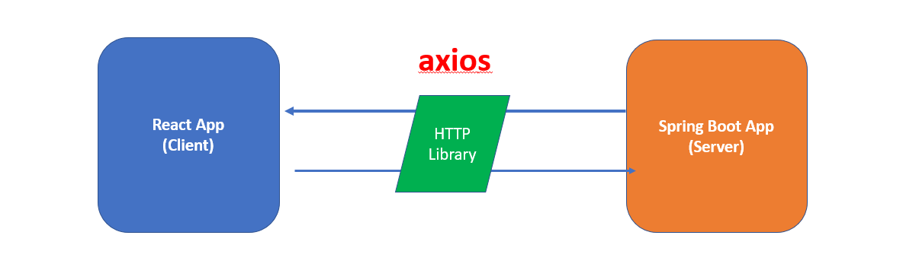
Architecture

Slide 5
Modules
Registration/Login Module
Admin can login through username and password. If not registered they can signup.
Students Module
Can add student information, such as fields (name, age, gender, phone number).

Slide 6
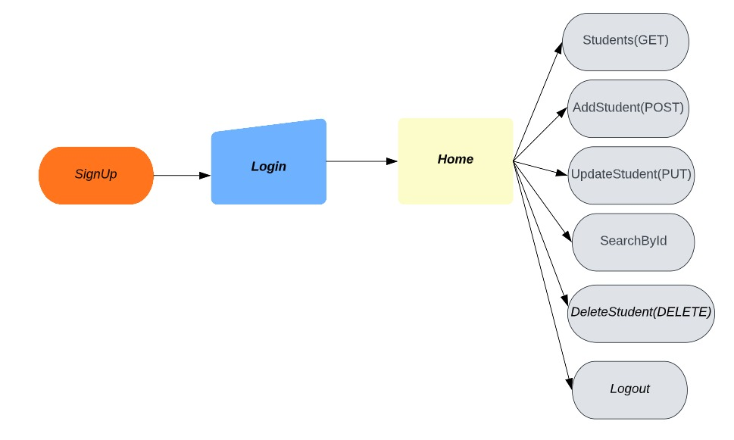
Flowchart

Slide 7
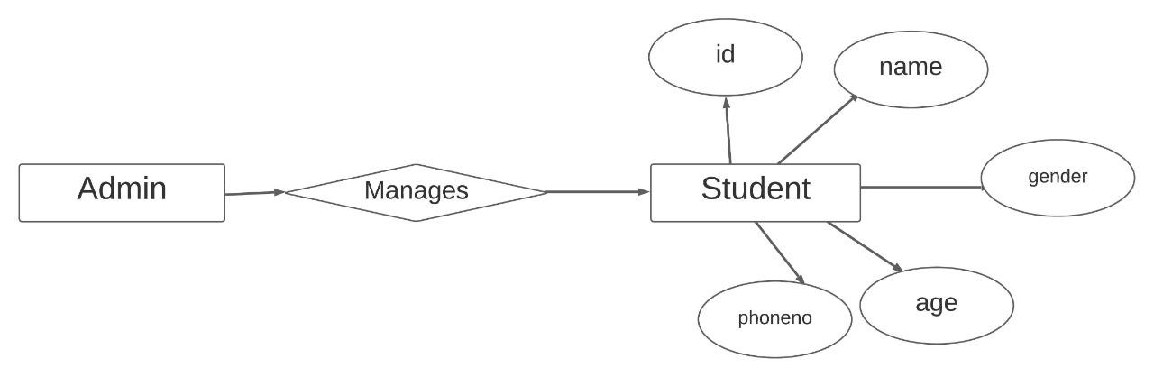
ER Diagram

Slide 8






Tools

Slide 9
Conclusion
Student Management System can be used by educational institutions to maintain their student records easily. Achieving this objective is difficult using the manual system as the information is scattered, can be redundant, and collecting relevant information may be very time-consuming. All these problems are solved by this project.

